Slide 1
The Roadmap to High School
The Enrollment Process 2025-2026
Jose Bañas Principal
Oscar Gomez, Assistant Principal
Allende Palma-Saracho, Assistant Principal
Matiana Pimentel, Community Liaison
Mountain View High School

Slide 2
Today’s Agenda
Introductions
Timeline of Events (Roadmap to High School)
Open House: Program Showcase for Students and Parents
8th Grade Preview Day: 8th Graders Visit High Schools
Pre-Registration Day: Class Selection Day
Registration Day: Official Enrollment & Pick up School Supplies
Question & Answer

Slide 3
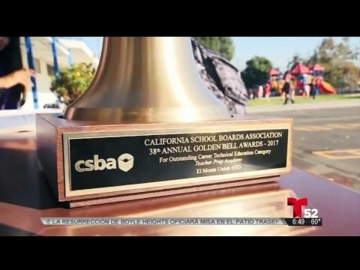
Welcome to MVHS

Slide 4
Spanish Language Placement Exam
Dates
Parkview: 12/12/2024
Twin Lakes: 12/11/2024
Purpose of Exam: Proper class placement
Spanish 1P (non-native speaker)
Spanish 2P (non-native speakers)
Spanish 1X (native spanish speakers)
Spanish 2X (native spanish speakers)

Slide 5
8th grade High School Preview Day
January 17, 2025
9am - 12pm @ Mountain View HS
8th grade students from Parkview, Twin Lakes, and Monte Vista will be transported to Mountain View High School to preview our school programs.
Campus tours
Performing Arts performances
School clubs and athletic team fair
Walk through our CTE programs (Teacher Preparation Academy, VISTA Video Production Academy, Banking, Culinary Arts, Zoo Crew)
Sign Ups for AVID, Academies, and more.
9:00 a.m. to 12:00 p.m.
Lunch provided

Slide 6
EMUHSD Pre-Registration Dates 2024-2025 school year
Feeder School | Receiving School | Pre-Registration Dates
Parkview MVSD | MVHS, SEMHS, EMHS | 1/24/2024
Monte Vista MVSD | MVHS, SEMHS, EMHS | 1/21/2024
Twin Lakes MVSD | MVHS, EMHS | 1/28/2024

Slide 7
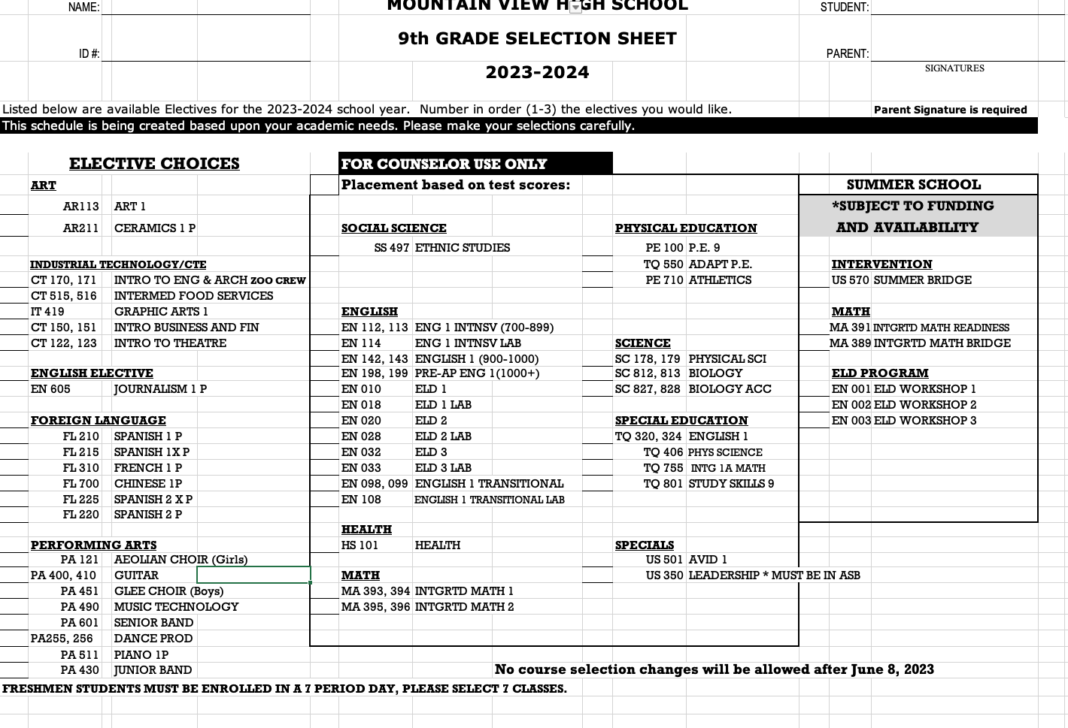
Pre-Registration Process 2025-2026
Students meet in person with their Guidance Counselor.
Counselors are based on alphabetical order of students’ last names
Class selection is based on teacher recommendation for core classes: English, Math, Science, PE, Ethnic Studies/Health
Freshmen students can select up to 3 electives
All Freshmen must be enrolled in 7 classes
Student will also enroll in Summer School 2025
8th grade students will be enrolled in Math courses: Math readiness, or Math readiness based on 8th grade teacher recommendation
Summer Bridge program for interested 8th grade students

Slide 8
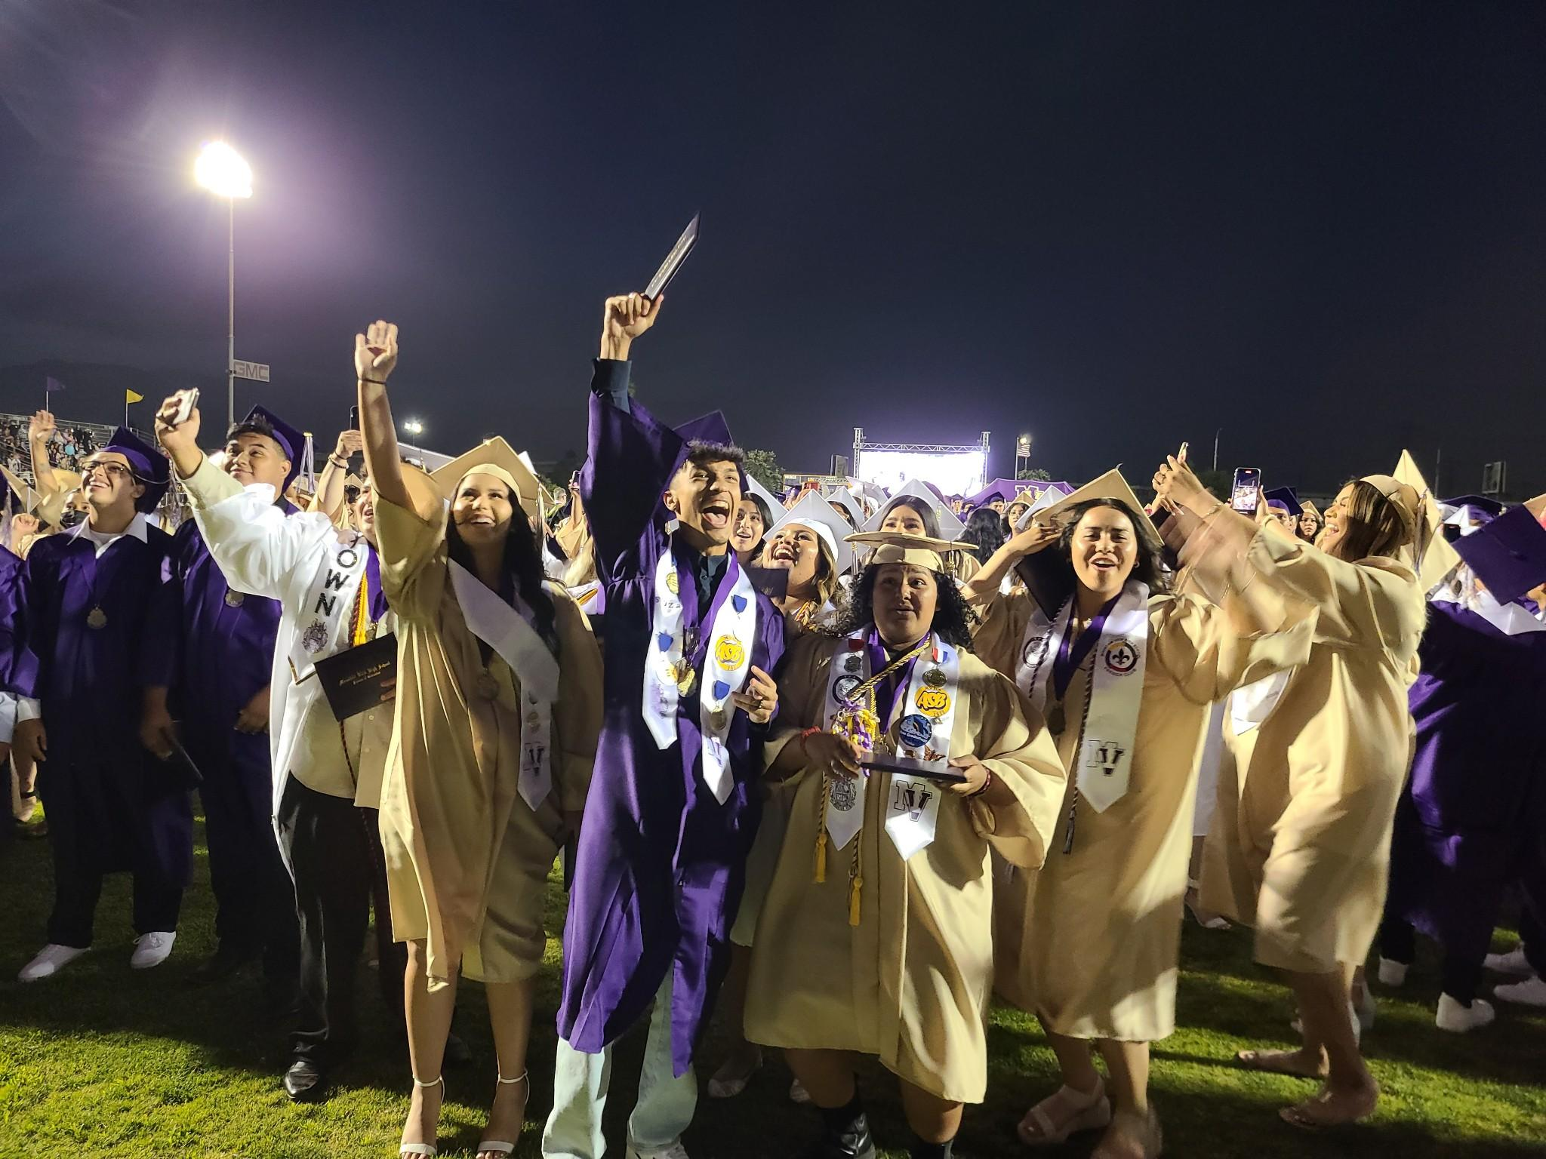
EMUHSD GRADUATION REQUIREMENTS
English: 40
Science (Biology and Physical 10 credits each) 20
Health: 05
Mathematics (Including Integrated 1) 20
World History: 10
United States History: 10
Economics: 05
U.S. Government: 05
Physical Education: 20
Fine Arts, Foreign Language, or CTE: 10
Ethnic Studies: 05 (class of 2024 and beyond)
Subtotal 145
Elective Subjects 75
Total credits required for graduation 220

Slide 9
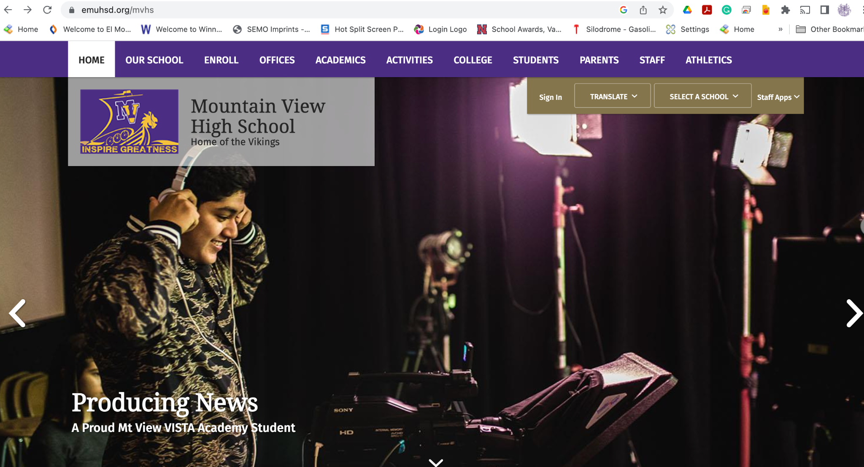
Mountain View High School Website: emuhsd.org/mvhs

Slide 10
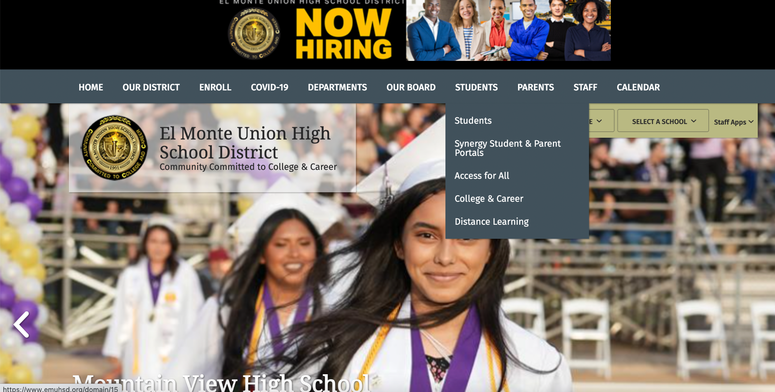
El Monte Union High School District Website
www.emuhsd.org

Slide 11
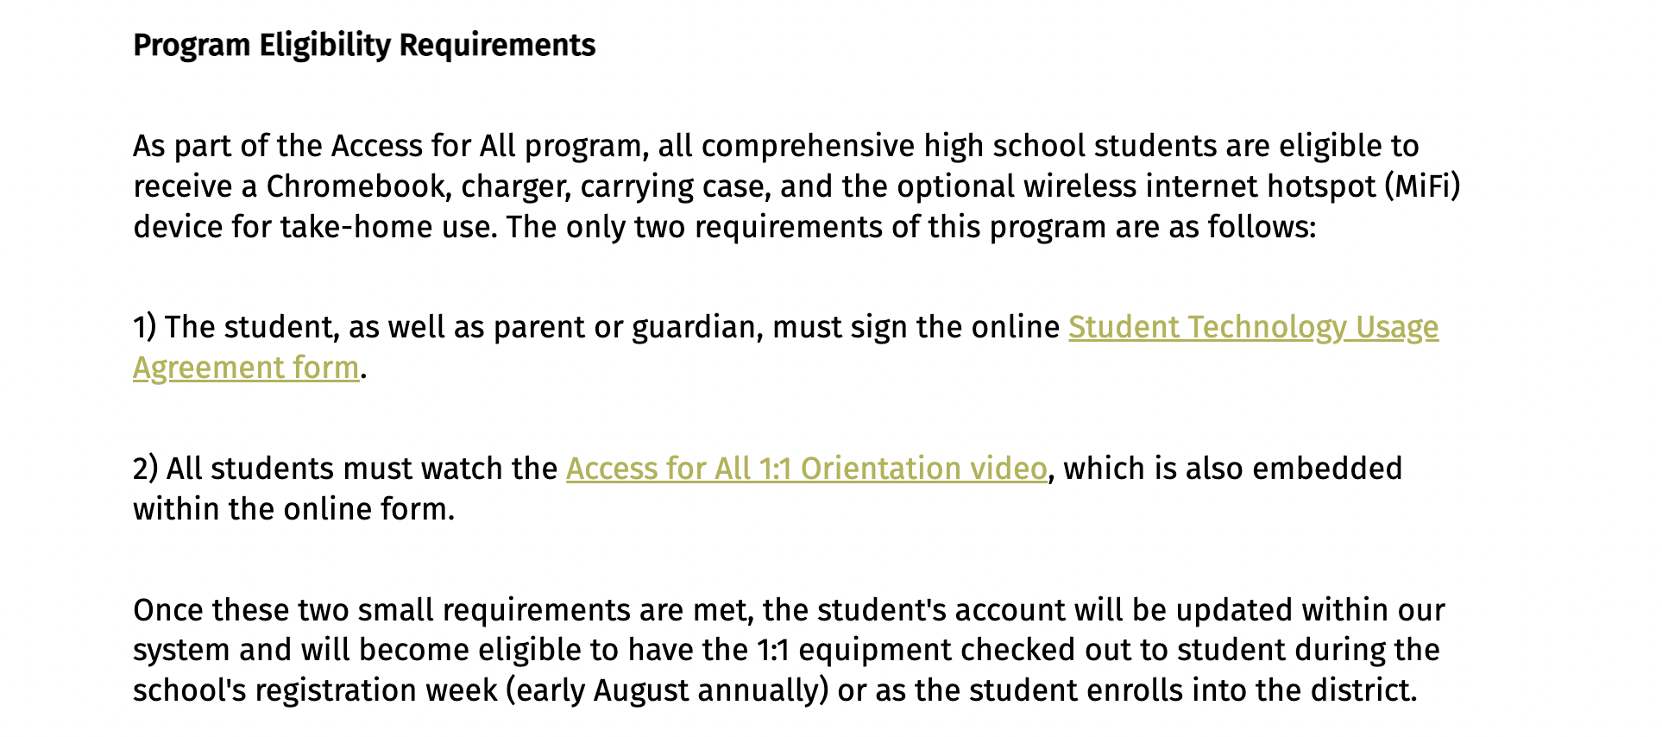
Access for All
All incoming students will receive a Chromebook for grades 9-12
Each student will be assigned an El Monte Union High School Google email address and password
Students should not change their passwords once assigned
All students will be provided with a personalized identification number (ID)
Students will complete the Student Technology Usage form prior to receiving their Chromebooks before the start of Summer School
Communication will take place through student and parent emails.
Students can also apply for free Mifi devices for WiFi service at home.

Slide 12
SYNERGY Online Portals
Parent online portal is called Parent Vue
Student online portal is called StudentVue
Students and parents can access student grades, attendance, contact teachers, request transcript and health information
www.emuhsd.org/synergyportal

Slide 13
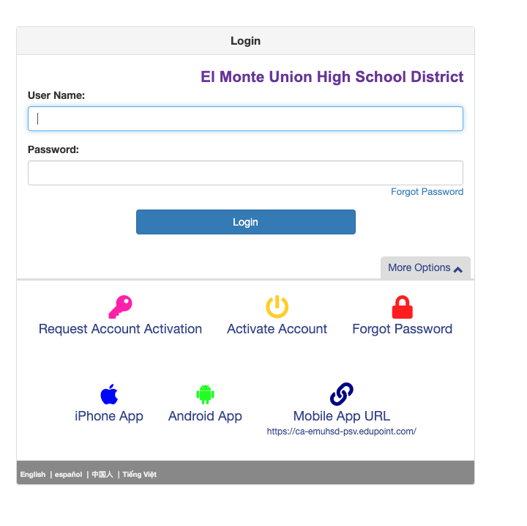
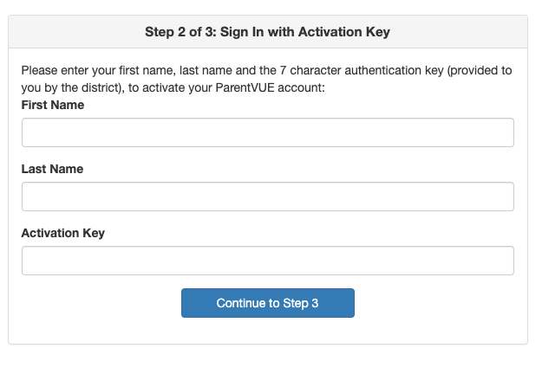
OLR: Online Registration 2024-2025
The parent online registration portal will begin Spring 2025. Registration August 2025.
All incoming 9th grade parents will receive an activation code to complete the Fall 2025-2026 registration.
Parents will need to create a parent account on Synergy ParentVue application.
Parents will update the following information: Parent/Guardian information, review home address, telephone number, parent email address, emergency contact information, food services, health information, immunizations
Incoming 9th grade student from MVSD are considered returning students not new.

Slide 14
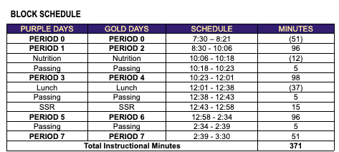
MVHS Bell Schedule
Block Schedule
Purple Days: Periods 1, 3, 5 & 7
Gold Days: Periods 2, 4, 6, 7

